Slide 1
Cap Store Application –
CHAT MODULE
- KB Aishwarya Lakshmi

Slide 2
CONCEPT:
To create a live chat script on customer page, merchant page and admin page.

Slide 3
CONCEPTS USED:
The Chat module has been created based on the web sockets and thymeleaf.
Instead of HTTP, WebSockets has been used.
This allows bidirectional data flow when compared to HTTP.
STOMP is used. STOMP stands for Streaming Text Oriented Messaging Protocol.
‘Thymeleaf’ template engine is used, which has more features than jsp.
Thymeleaf is based on HTML, which is more easy to read when compared to jsp pages.
Notes:
Fixar a posicao do titulo – sempre do lado esquerdo.
Sempre que tiver muito texto o coluna deve sempre ser “ narrowed” , se nao fica dificil de ler. Colocar paragrafos no texto.
Linha vertical deve ser mais fina e as pontas NUNCA devem ser arredondadas.

Slide 4
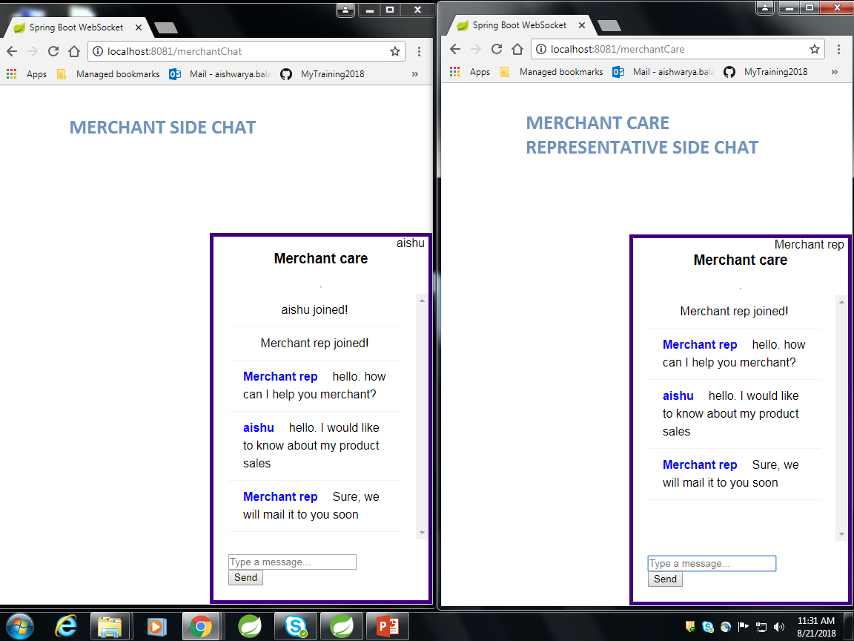
MERCHANT – MERCHANT REPRESENTATIVE CHAT

Slide 5
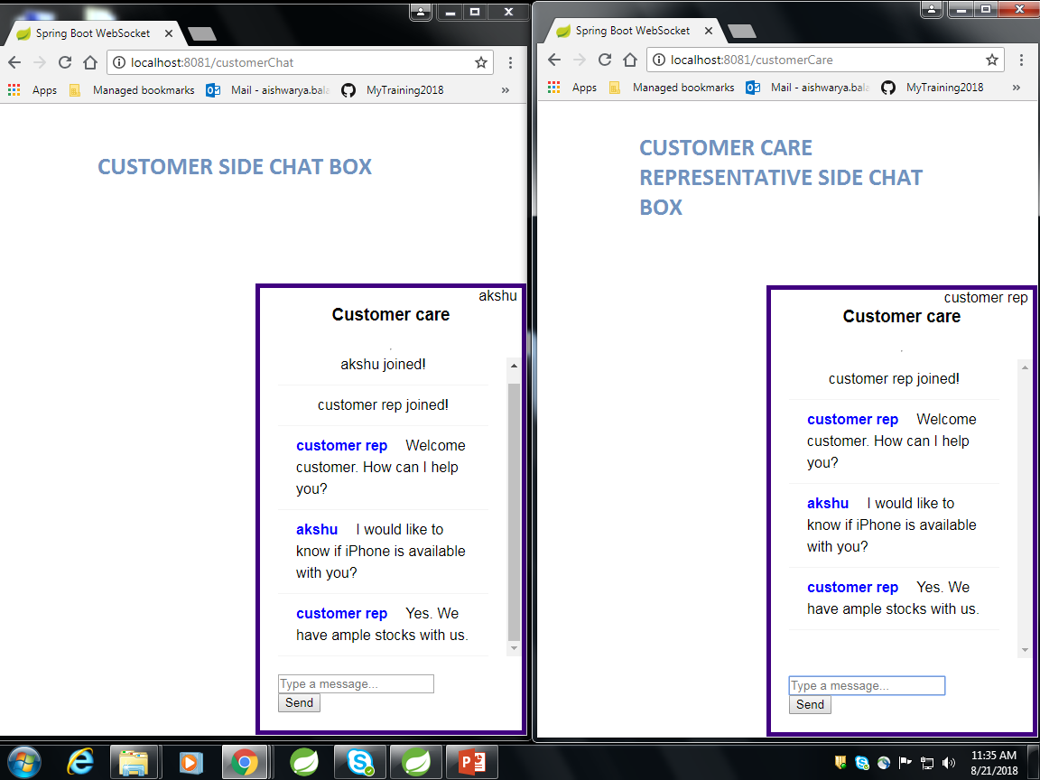
CUSTOMER – CUSTOMER REPRESENTATIVE CHAT

